Slide 1

for and against essay: check up

Slide 2
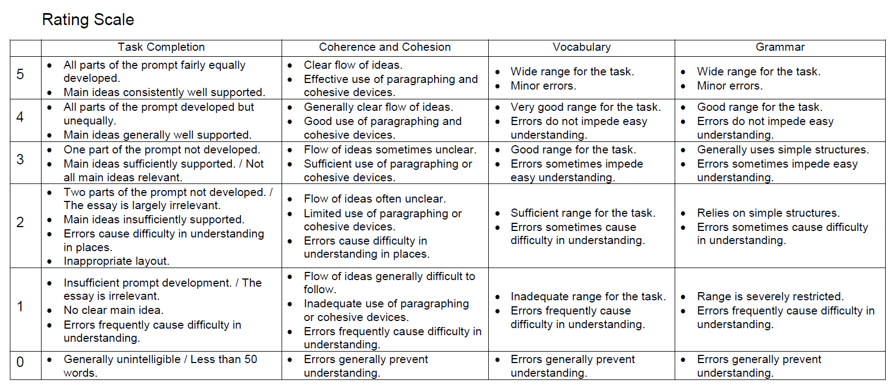

Slide 3
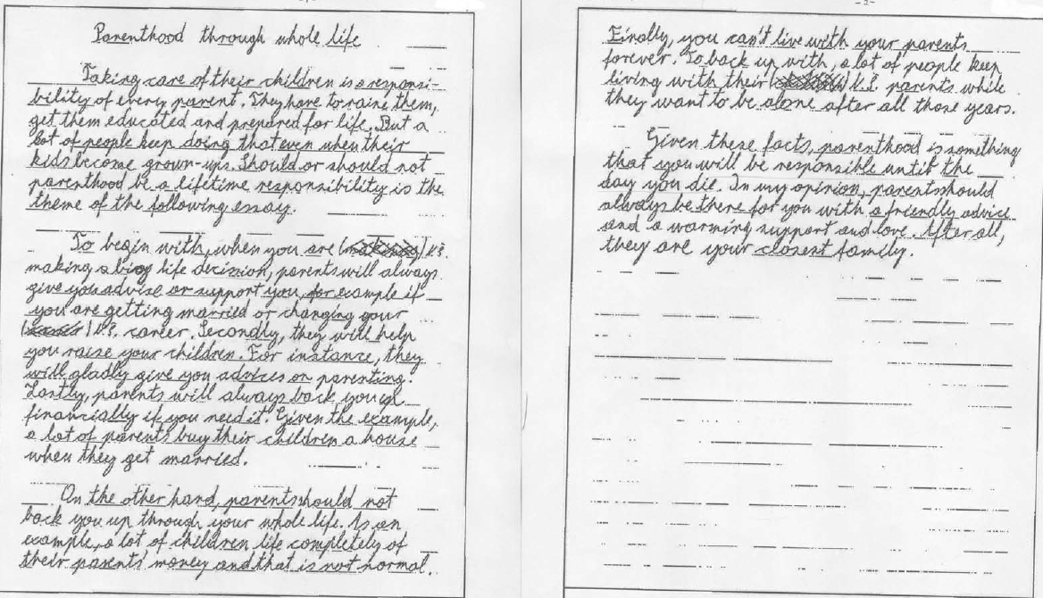
Essay 2.

Slide 4
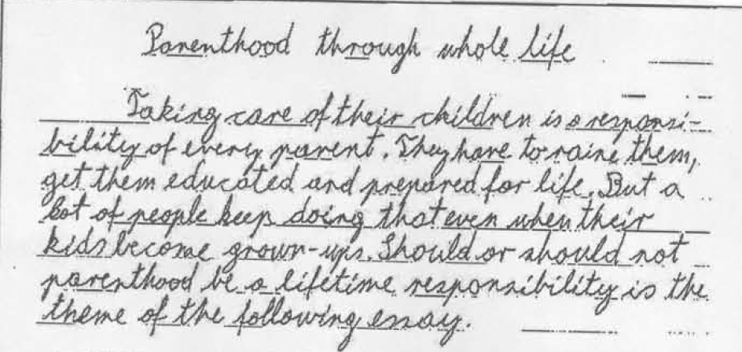

Slide 5
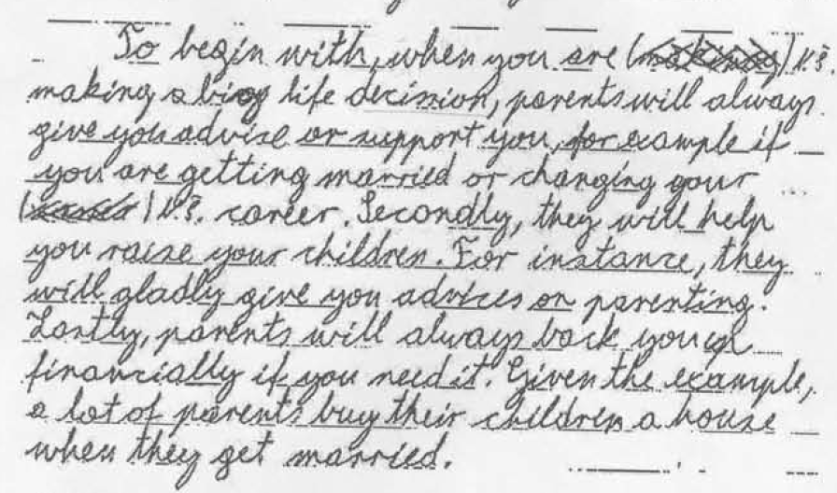

Slide 6
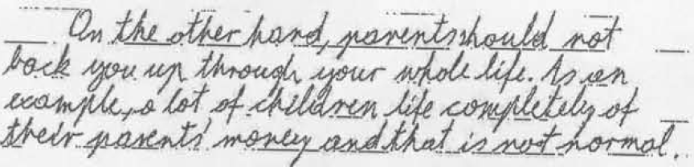
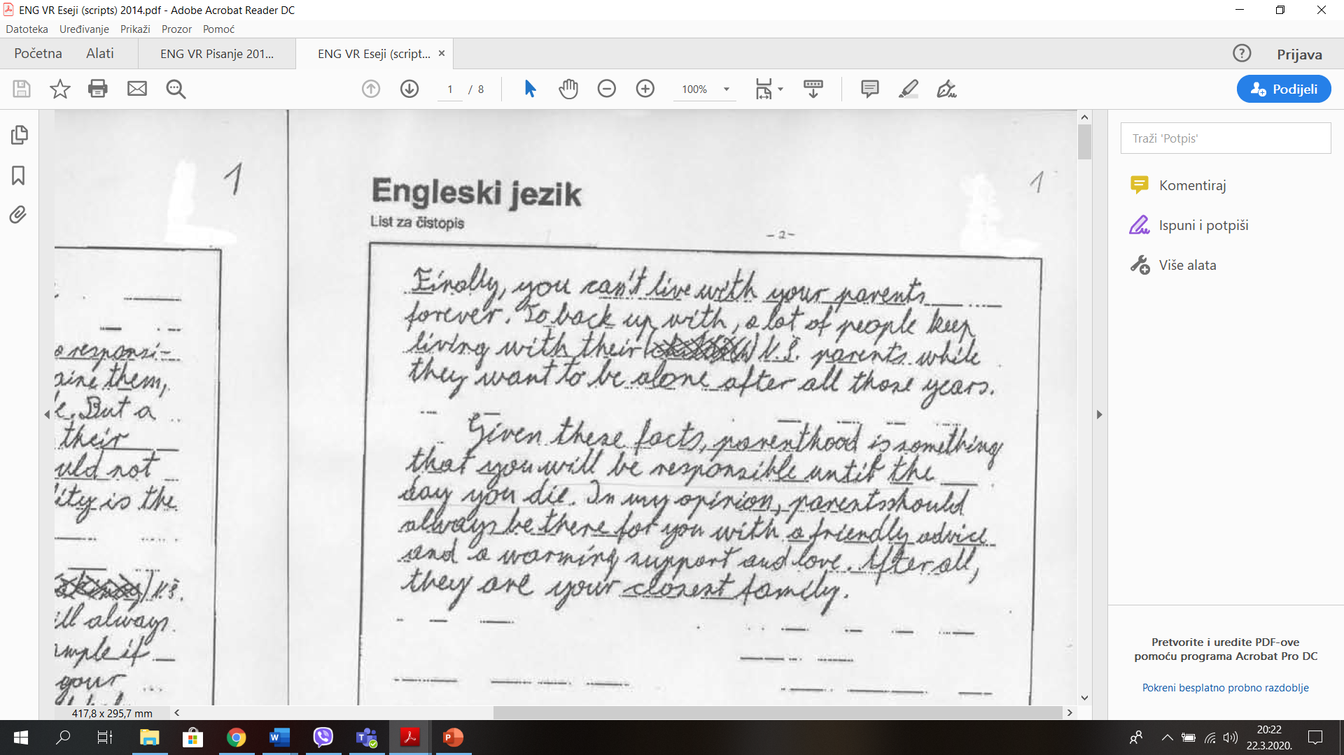

Slide 8
What is the topic here?
Even though having a luxurious house sounds like a dream come true, some would replace it with the practicality of an apartment. Is a house really an ideal home or could a flat be a more convenient place of living?

Slide 9
Topic?
In conclusion, a house is a proper place for raising a family, while flats are more economical, perfect for single-headed, or two-headed households without pets. Still, choosing between the two depends on one’s preferences and needs.

Slide 10
Introduction: 0, ½ or 1?
Nowadays, there are multiple ways to travel by different kinds of transport. Development in all aspects also leads to modernization and development of transport. While some prefer to travel by boat considering is more relaxing, others claim is a waste of time.
Zero sentence
Topic in new words
+/-

Slide 11
Introduction: 0, ½ or 1?
In this day and age there are multiple ways of travel and transport, one of them being boats. Some consider that traveling by boats may take too long while others enjoy taking their time. So, is this option a waste of time or an invigorating, new experience
Zero sentence
Topic in new words
+/-

Slide 12
Introduction: 0, ½ or 1?
In this day and age there are multiple ways of travel and transport, one of them being boats. Some consider that traveling by boats may take too long while others enjoy taking their time. So, is this option a waste of time or an invigorating, new experience
Zero sentence
Topic in new words
+/-

Slide 13
Introduction: 0, ½ or 1?
In this day and age there are multiple ways of travel and transport, one of them being boats. Some consider that traveling by boats may take too long while others enjoy taking their time. So, is this option a waste of time or an invigorating, new experience?
Zero sentence
Topic in new words
+/-

Slide 14
Conclusion: 0, ½ or 1?
To conclude, although they're not that roomy, flats are definitely a practical, convenient and maybe the only option if you are living in a city. For me that will never be an option, but I can also see why some people are attracted to them more than to a house.
Short summary, +/- topic check!
Opinion + explanation

Slide 15
Conclusion: 0, ½ or 1?
To sum up, although boat voyages can be very amusing and you can really enjoy by travelling on it, it also have some negative sides such as the boat sickness or the slowness that it brings. However, in my opinion travelling by boat is great way to use your time and it can also encourage you to socialize with your family and friends.
Short summary, +/- topic check!
Opinion + explanation

Slide 16
Conclusion: 0, ½ or 1?
All things considered, travelling by boat may take you longer, but I believe if you have time to spare, you can take the advantage of the many facilities which boats have to offer. Go for it and have a pleasant voyage.
Short summary, +/- topic check!
Opinion + explanation

Slide 17
Conclusion: 0, ½ or 1?
All things considered, traveling by boat will certainly take longer, but maybe the beautiful sights and wonderful experiences are actually quite worth it. Personally, I would love to travel by boat now and again, but I don't think I would use it as my preferred method of transport.
Short summary, +/- topic check!
Opinion + explanation

Slide 18
Extra topics
Some essay topic suggestions:
    Smoking should be banned completely
    Being a teacher is the best job ever
    Arranged marriage – the right way to go?
    Credit cards – a blessing or a curse?

